Slide 1
PART 2

Slide 2
Living Like There's No Tomorrow
1 Peter 4:7-11
People have been predicting the end of the world since the beginning of the world. But Scripture declares there will be an end. For some, their world could end this week or this year when death pays them a visit.

Slide 3
Living Like There's No Tomorrow
1 Peter 4:7-11
But with whatever time we have left, we should live with a sense of imminence and anticipation that God's kingdom is around the corner. There are three timeless principles that we can learn to make our lives stronger as we await the end of the age?

Slide 4
1.Pray Harder (v. 7)
Because Time Is Short

Slide 5
1.Pray Harder (v. 7)
Because Prayer Is Powerful
What will sustain you more than anything else is a solid prayer life

Slide 6
2. Love Deeper (vv. 8-9)
Love is the identification mark of the Christian—the birthmark
Literally means strenuously
When you love people, give it all you've got

Slide 7
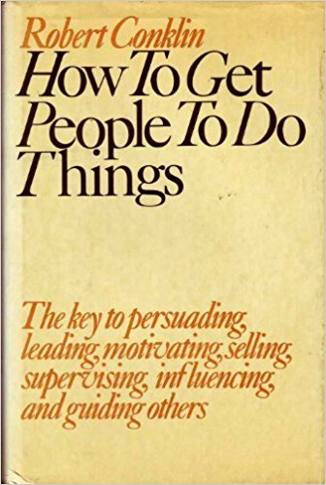
2. Love Deeper (vv. 8-9)

Slide 8
3. Serve Smarter (vv. 10-11)
Every Christian has a spiritual gift
Your gift may be different from somebody else's gift
Whatever gift you have, you should use it to help other people
Some gifts are noticeable and others are unnoticeable, but all of them are helpful

Slide 9
3. Serve Smarter (vv. 10-11)
The reason we share our gifts with other people is to glorify God
"Manifold grace" (v. 10)
Manifold means many - colored

Slide 10
3. Serve Smarter (vv. 10-11)
Paul's description is the body of Christ; 1 Corinthians 12:4-31
God has no hands but yours; He has no feet but yours; He has no mouth but yours
We're the expression of Jesus Christ by what we do

Slide 11
Closing Thoughts
We belong to the greatest organization in the world
We have a product that works universally
We have offices worldwide

Slide 12
Closing Thoughts
We have a pretty good benefits package
We have a retirement package that's off the charts
The problem is we're running out of tomorrows; all we have is today

Slide 13
Closing Thoughts
Today, what will your anthem be: less for Christ, or more for Christ?
When prayer is fervent, love is preeminent, and serving is prominent, then God is glorified, the church is edified, and the world is notified that God is real

