Slide 1
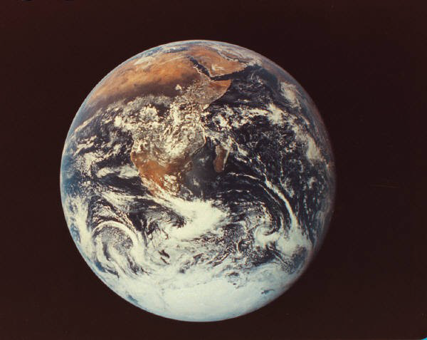
ALL OF ME PSALM 100
ALL OF ME
PSALM 100
How should we treat the One who loves us consistently and provides for us faithfully?
As a believer, what would you do differently?

Slide 2
ALL OF ME PSALM 100
How should we treat the One who loves us consistently and provides for us faithfully?
If you had your life to live over what would you do differently?
As a believer, what would you do differently?

Slide 3
ALL OF ME PSALM 100
Everybody on earth has some response to God
Some ignore Him
Some abhor Him
Some adore Him

Slide 4
Four Appropriate Responses to God
Worship
Serve
Love
Thank

Slide 5
Worship God Joyfully (vv. 1, 2)
Make a joyful shout
Come before His presence with singing
Shout to the Lord
is mention 17-18 times in Scripture

Slide 6
Worship God Joyfully (vv. 1, 2)
Numbers 23
Joshua 6
I Samuel
3rd Chapter of the Book of Ezra

Slide 7
Worship God Joyfully (vv. 1, 2)
C. H. Spurgeon
"Our happy God should be worshiped by a happy people; a cheerful spirit is in keeping with His nature, His acts"

Slide 8
Excuses For Not Serving God Joyfully
"I don't have a good voice"
“I don't feel like it”
"I'm not the emotional type"

Slide 9
Some folks will complain in heaven
It'll be too loud
Isaiah 6:4; Revelation 5:11-12
Because of the lights
Revelation 21:23; 1:16
Because of the haze Isaiah 6:4

Slide 10
Serve God Gladly (v. 2)
God wants more than fans; God wants followers
Spiritual maturity isn't measured by glorious singing as much as by glad serving
Worshipping is a lot better than whining
God loves a cheerful giver God also loves a cheerful liver

Slide 11
Love God Intelligently (v. 3)
Christians should be great thinkers
What are we to know?
His Lordship

Slide 12
Love God Intelligently
His craftsmanship
Know that the Lord He is God; it is He who made us
You are a special creation of God
You are not a human accident; you are a divine incident
His ownership
You are His by creation

Slide 13
Love God Intelligently
If you're a believer, you are His by redemption; Revelation 5:9
Ownership implies care
Romans 8:38-39

Slide 14
Thank God Consistently (vv. 4-5)
Enter His gates with thanksgiving and into His courts with praise, be thankful to Him and bless His name, for the Lord is good, his mercy is everlasting, and His truth endures to all generations.

Slide 15
Thank God Consistently (vv. 4-5)
Three reasons to thank God
He is good
He is merciful
He is honest
1 Thessalonians 5:18
In everything give thanks; for this is God's will for you in Christ Jesus.

Slide 16
ALL OF ME PSALM 100
Four Appropriate Responses to God
Worship God joyfully
Serve God gladly
Love God intelligently
Thank God consistently
God Wants All Of You

